Slide 1

RAD Presentation PART2
521H0179
Nguyễn Trần Trường Tú

Slide 2
1. USER-STORY
The account manager wants to provide accounts for employees to log into the system to work, they need to manage those accounts.
User-Goal: - The account manager can view staff account list
- The account manager create new account for new staff
- The account manager can edit staff account information
- The account manager can delete staff account.

Slide 3
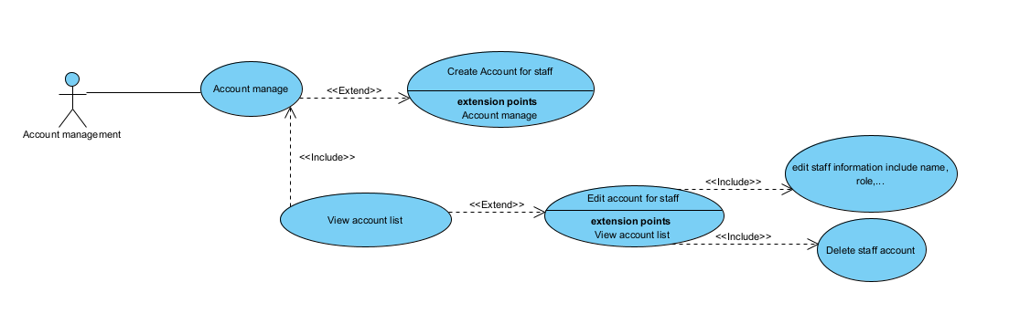
1. USE-CASE

Slide 4
USE-CASE DECRIPTION
Use-case ID | UC 01
Use-case name | Account manage
Actor | Account management
Pre-condition | Must be logged in, User must be account management
Trigger | After account management loggedin
Post condition | Succesfully add new account for new staff
Main scenario | (a)System show list of staff account (b)System show button Add new account
Alternatives | (a)1 Move to list of staff account page when user click in (UC 02). (b)1 Open New Account Form when user click in. (b) 2 show success notification if succesfully add new account (b) 3 show error notification if it’s fail.

Slide 5
USE-CASE DECRIPTION
Use-case ID | UC 02
Use-case name | View account list
Actor | Account management
Pre-condition | Must be logged in, User must be account management
Trigger | Afteruser click list of staff account (UC 01)
Post condition | User can view account list and edit or delete accounts.
Main scenario | (a)System show list of staff account with detail (b)System show edit and delete button on each account row.
Alternatives | (b) 1 If user click edit, show a form with account information. (b) 1.2 If edit success, system will show success notification. (b) 1.3 If edit fail, system will show fail. (b) 2 If user click delete, account in that row will delete.

Slide 6
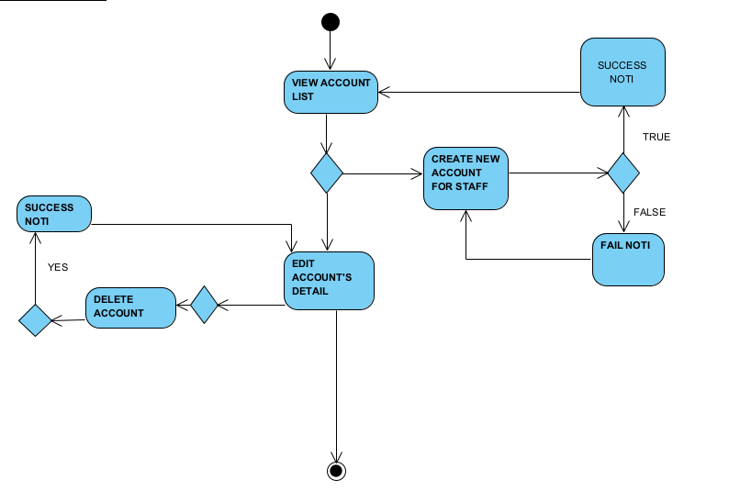
2. ACTIVITY DIAGRAM

Slide 7
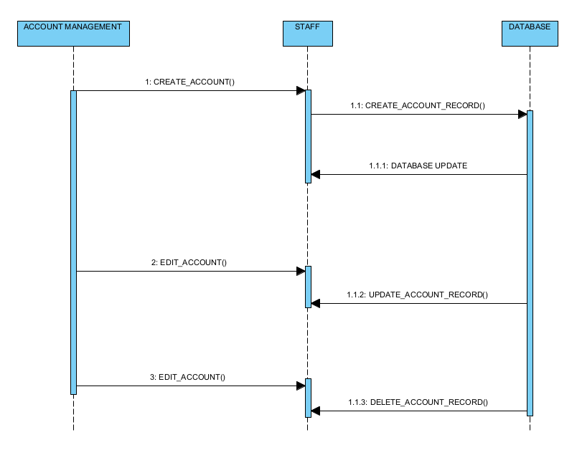
3. SEQUENCE DIAGRAM

Slide 8
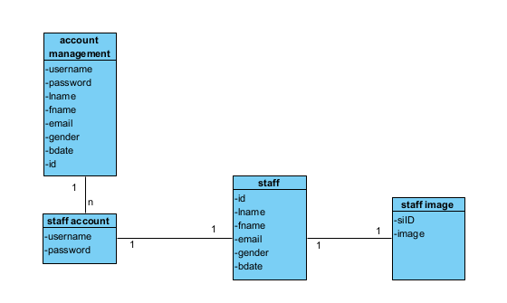
4. DOMAIN CLASS DIAGRAM

Slide 9
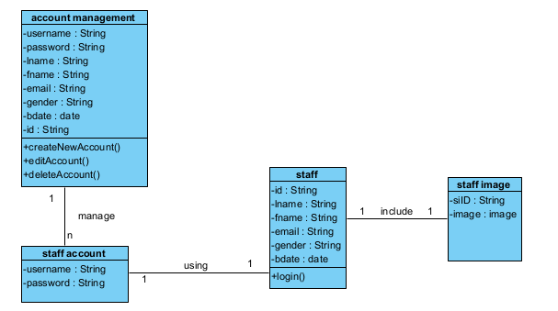
4.DESIGN CLASS DIAGRAM

Slide 10
4. DOMAIN CLASS DIAGRAM
Identify object classes
Object classes | Attributes
Account management | Username,password,lname,fname,email,gender,bdate,id
Staff account | Username,password
staff | Id,lname,fname,email,gender,bdate
Staff image | siID,image

Slide 11
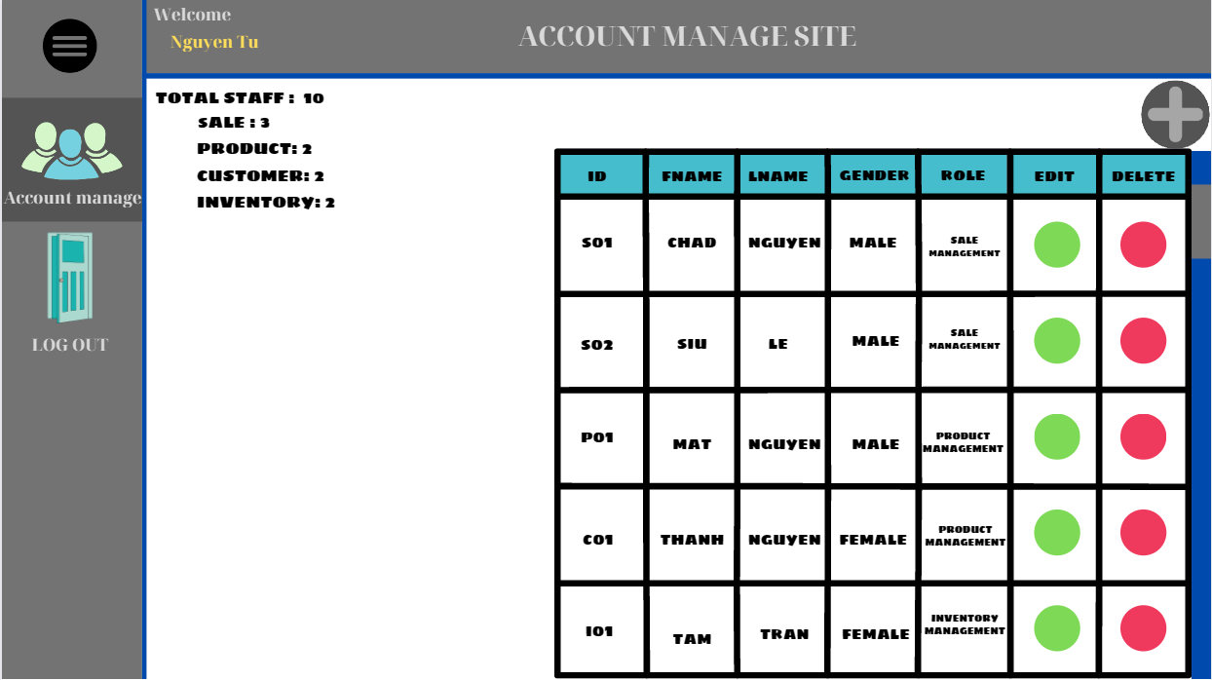
4. UI(demo)

Slide 12
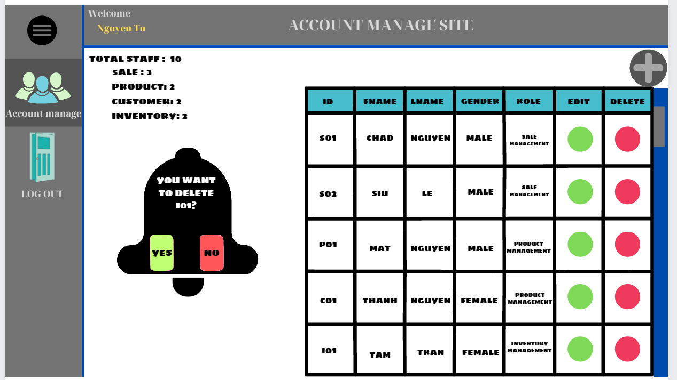
4. UI(demo)
using delete button

Slide 13
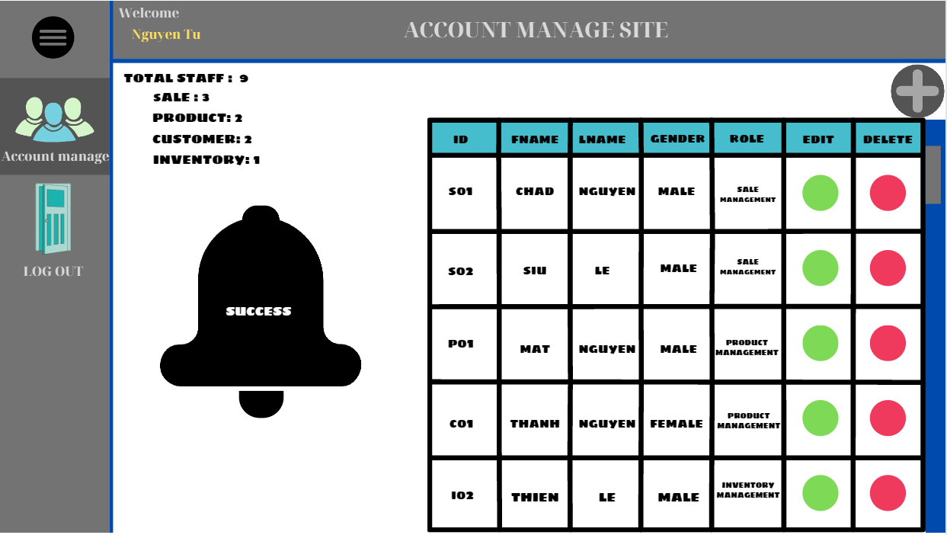
4. UI(demo)
success delete account

Slide 14
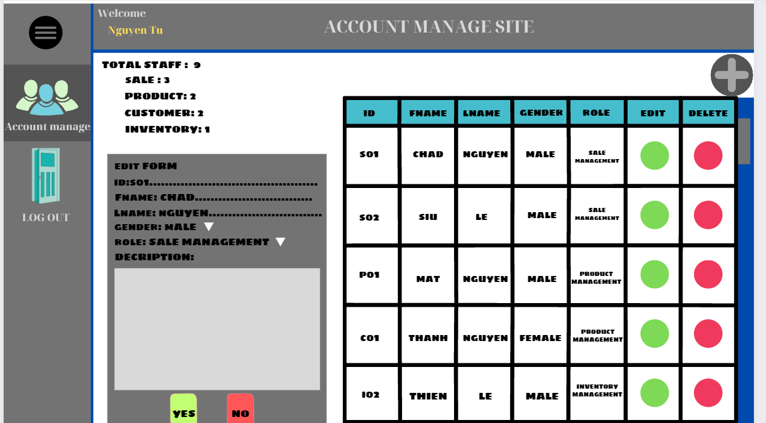
4. UI(demo)
using edit button

Slide 15
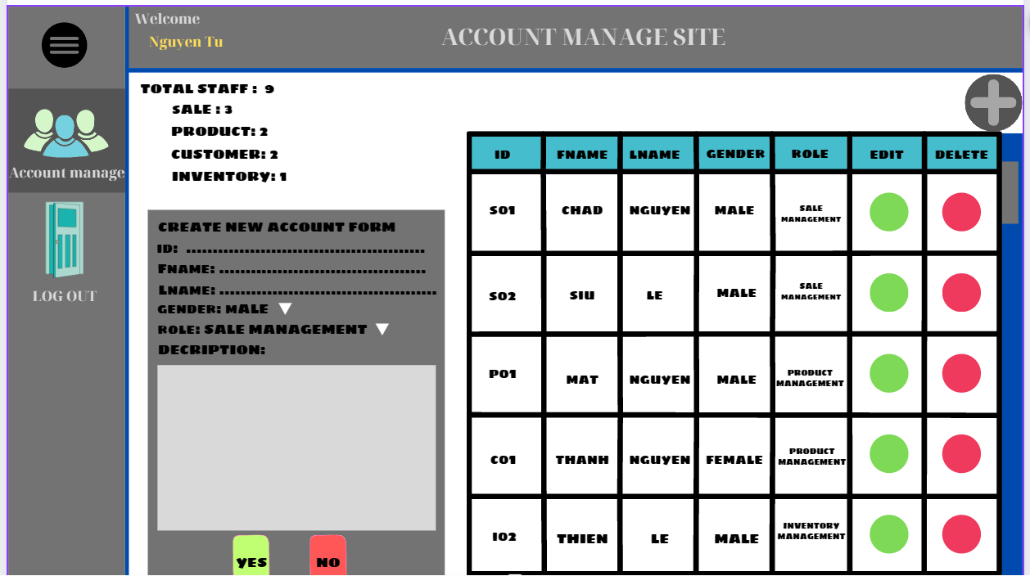
4. UI(demo)
using add button

Slide 16
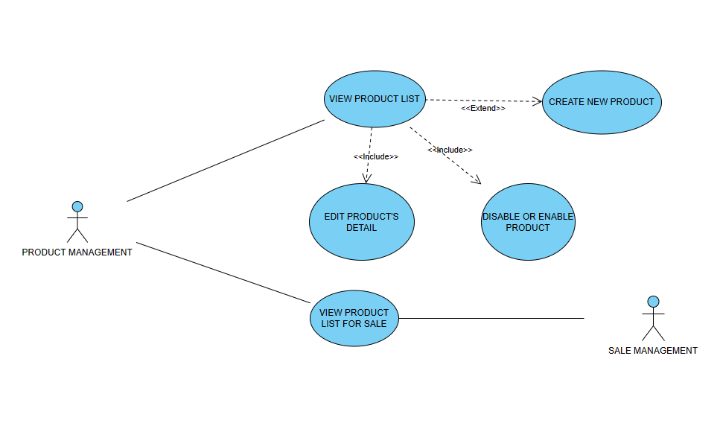
1. USE-CASE

Slide 17
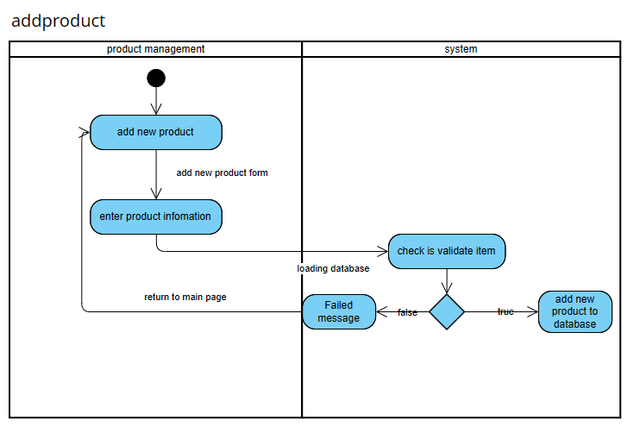
1. activity diagram for create new product

Slide 18
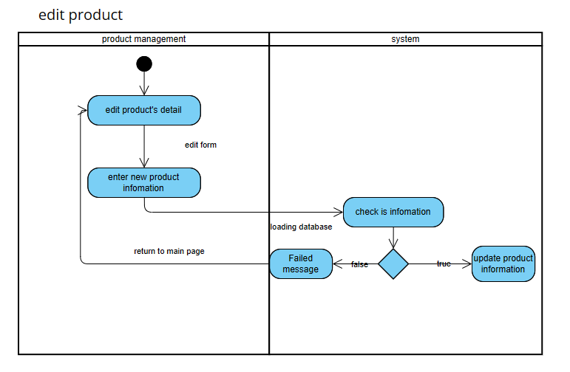
1. activity diagram for edit product information

Slide 19
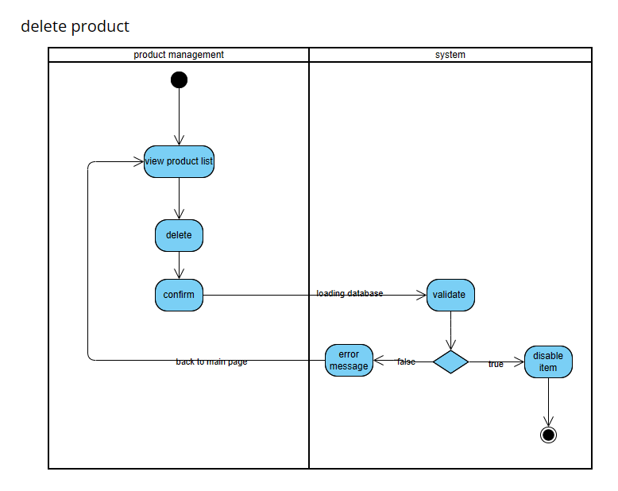
1. activity diagram for remove product information

Slide 20
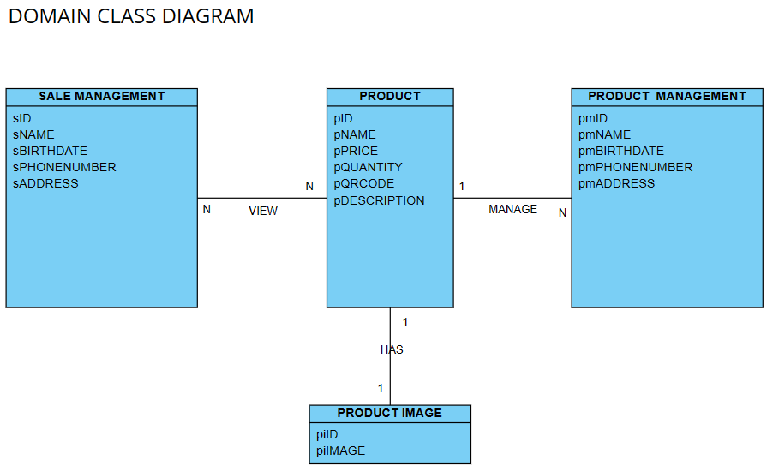
1. DOMAIN CLASS DIAGRAM

Slide 21
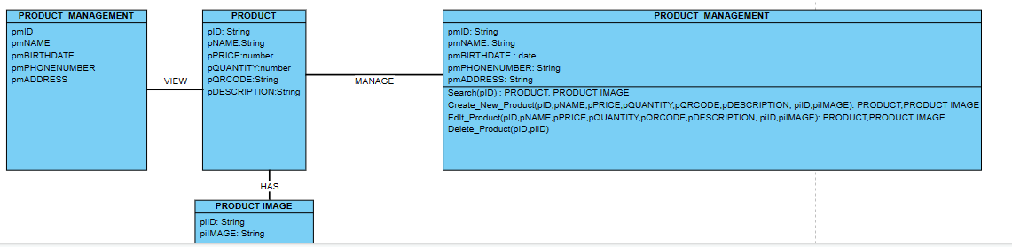
1. DESIGN CLASS DIAGRAM

Slide 22
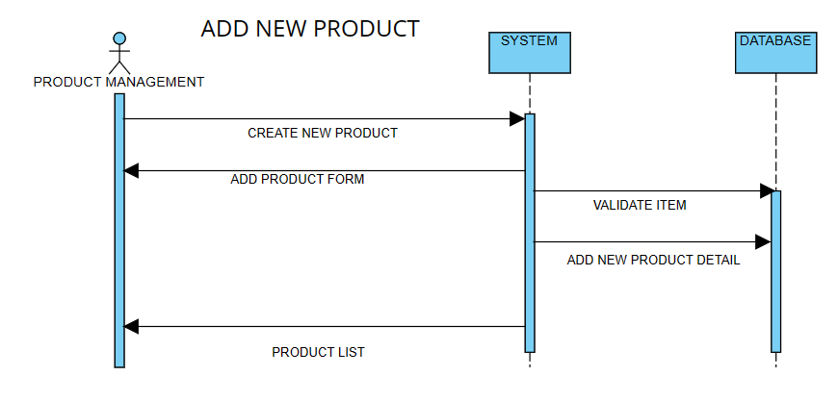
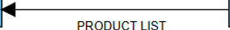
1. SEQUENCE DIAGRAM

Slide 23
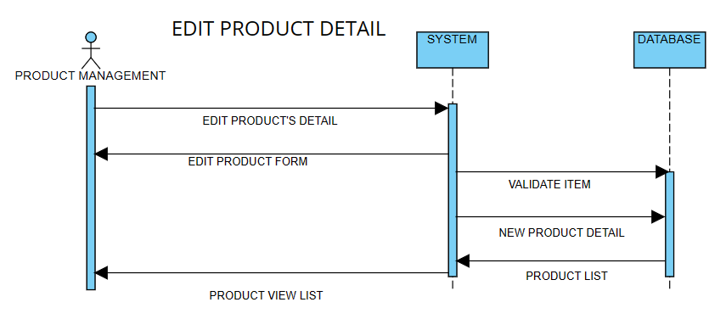
1. SEQUENCE DIAGRAM

Slide 24
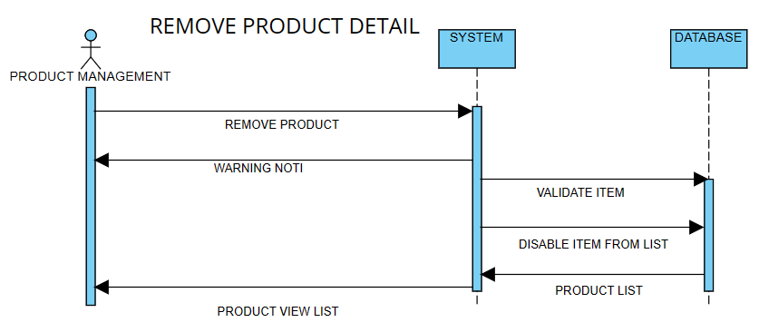
1. SEQUENCE DIAGRAM

Slide 25
1. SEQUENCE DIAGRAM

Slide 26
THANK YOU

